Slide 1

technical test developer backend S4N
By Luis Eduardo Barreto Santamaria
eduardobarreto19@Gmail.com

Slide 2





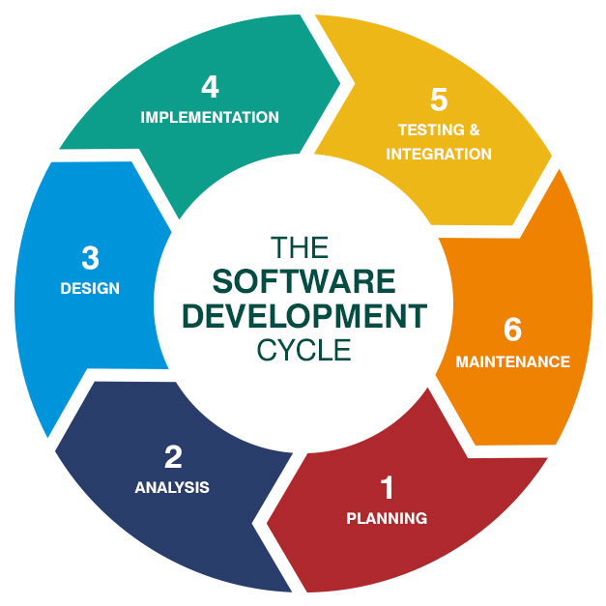
Proposed solution perspective
20 % time
20% time
30 % time
20% time
10 % time
Planning and Analysis
Design
Implementation
Testing
Integration
Software Development life Cycle

Slide 3
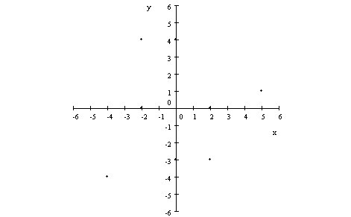


Planning and Analysis
: READ AND IDENTIFY FUNCTIONAL REQUIREMENTS
Situation proposed by S4N
Situation proposed by me
INPUT
INPUT
OUTPUT
OUTPUT
(0 , 0) dirección Norte
(-2, 4) dirección Norte
(-3, 3) dirección Sur
(-4, 2) dirección Oriente
AAAAIAA
DDDAIAD
AAIADAD
(0 , 0) dirección Norte
(-2, 4) dirección Occidente
(-1, 3) dirección Sur
(0, 0) dirección Occidente
AAAAIAA
DDDAIAD
AAIADAD
1
2
3
Conlusion: It is ok – it’s mathematically possible
Key: Direction drone
Conlusion: It is wrong - it is not possible mathematically

Slide 4





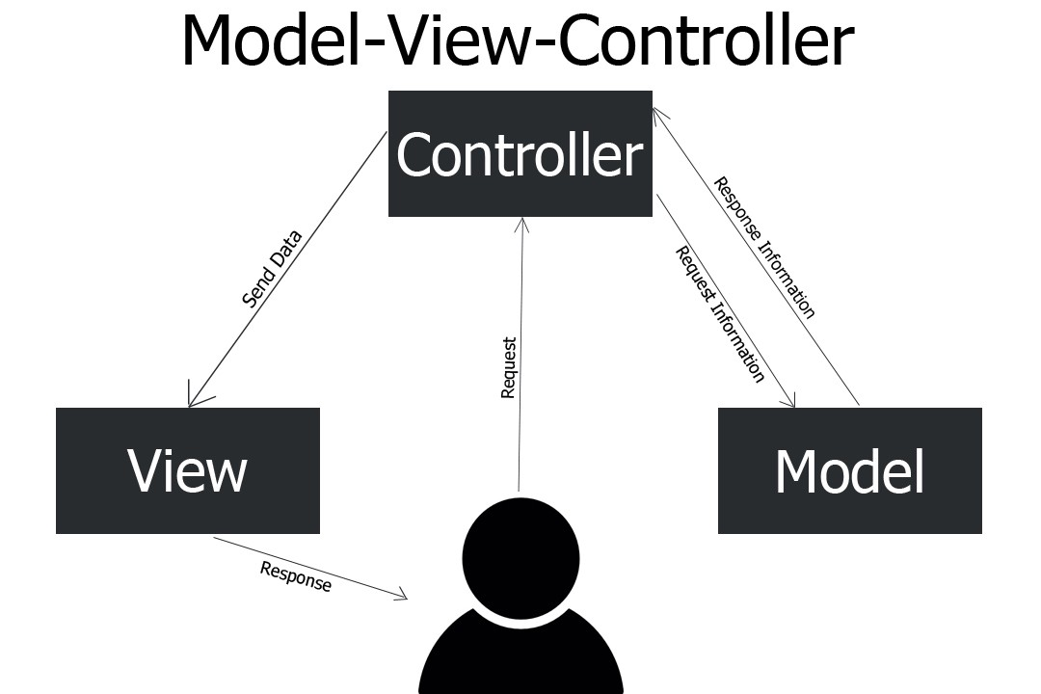


DESIGN
UML DIAGRAM
Software Architecture pattern
Technologies
Class diagram
Java SE
JDK 1,8
Eclipse IDE 2020-03
Junit5 to make testing
Remote Repository GITHUB
https://github.com/eduardobarreto19/Project_Drones/tree/develop

Slide 5
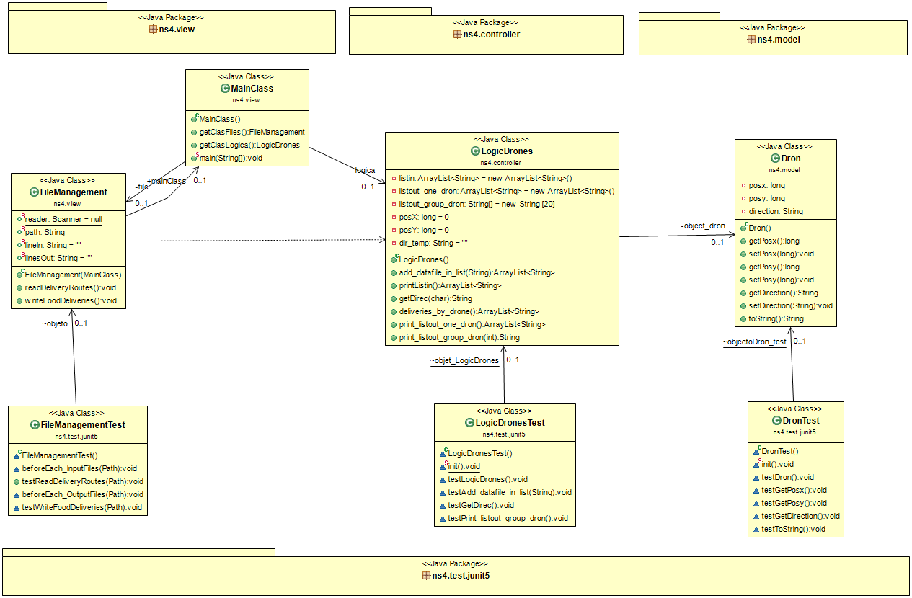

Slide 6
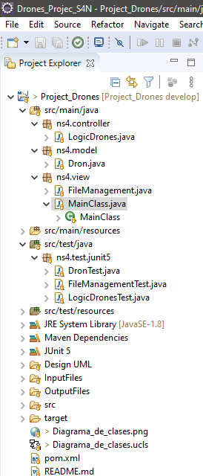

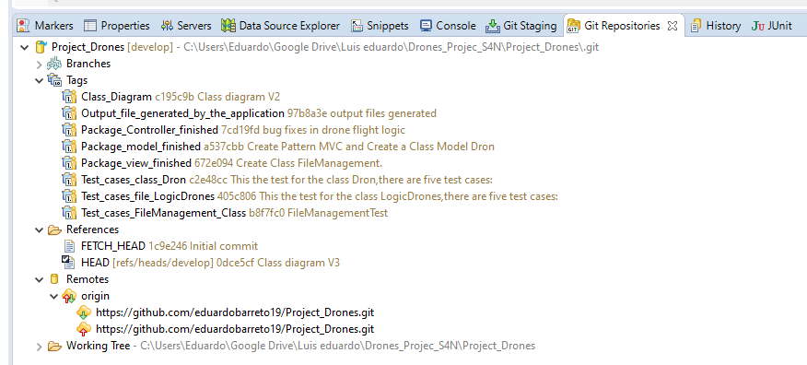
IMPLEMENTATION
Maven Project in Java
Object Oriented Programming - POO
GitFlow - Tags with GITHUB

Slide 7

TESTING – JUNIT5
FileManagementTest
LogicDrones
Dron
Input Files Testing
Output Files testing
Direction Dron testing
Location Dron Testing
Read and write chains on cartesian plane
Testing Objects Dron

Slide 8

ThanK you
Luis Eduardo Barreto Santamaria
Candidate
eduardobarreto19@Gmail.com
321 236 37 27

